Slide 1


Gesture Volume Control with Hand Gestures
BY: MATTEPALLY SIRI CHANDANA

Slide 2
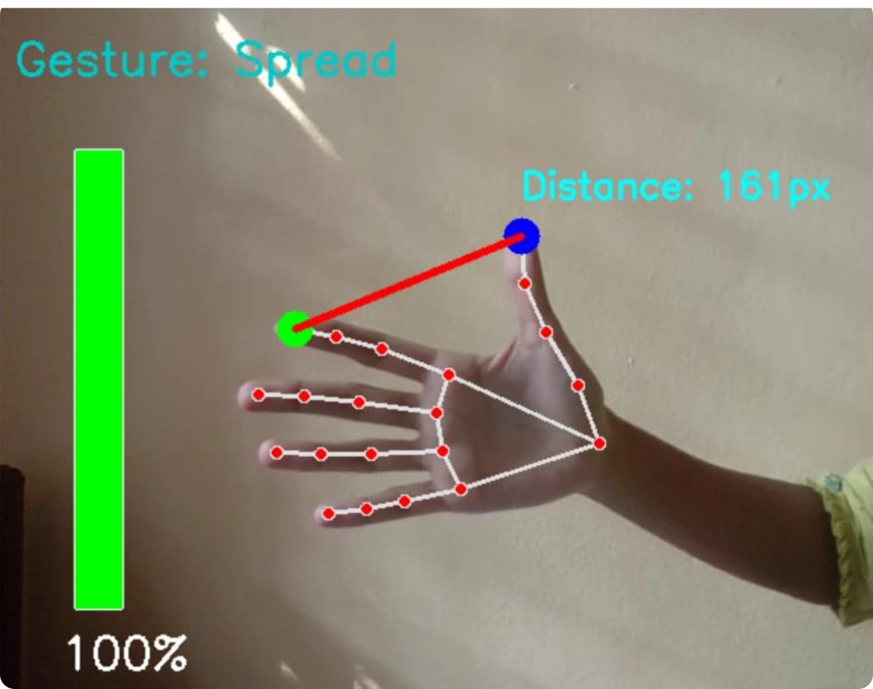
Introduction
This project builds a computer vision-based system to control volume using hand gestures. It detects hand landmarks via MediaPipe and maps gesture distances to volume levels. This enables a touch-free, intelligent interface for smart environments and assistive tech.

Slide 3
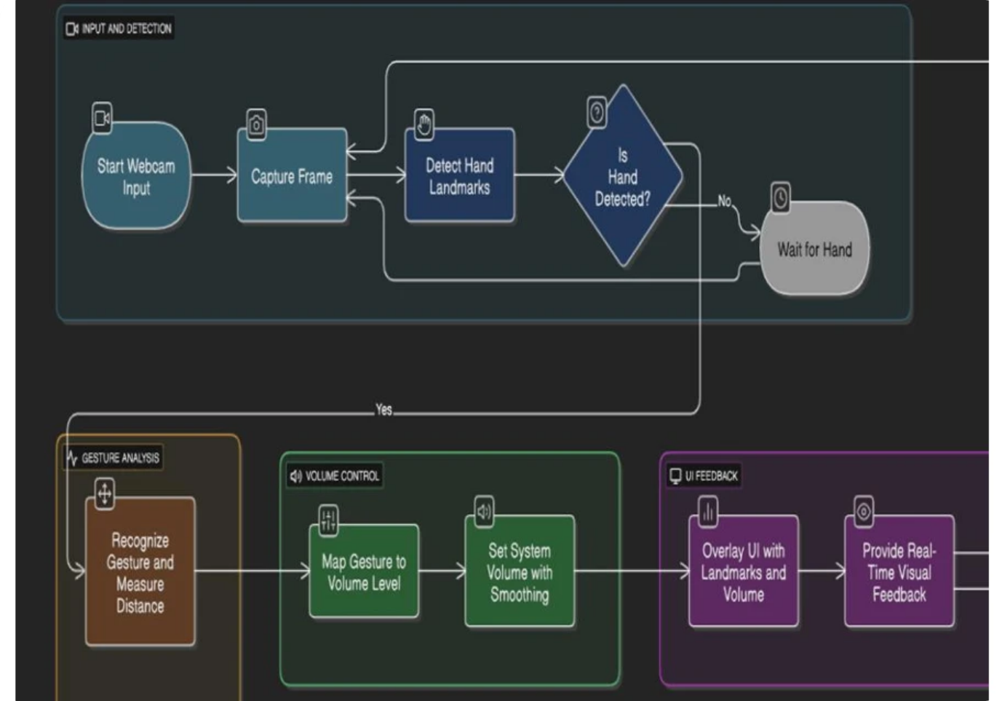


Workflow of the Project
Capture real-time video using OpenCV.
Detect hand landmarks using MediaPipe.
Measure distance between thumb and index finger.
Map gesture distance to system volume via Pycaw.
Display feedback on live feed.

Slide 4



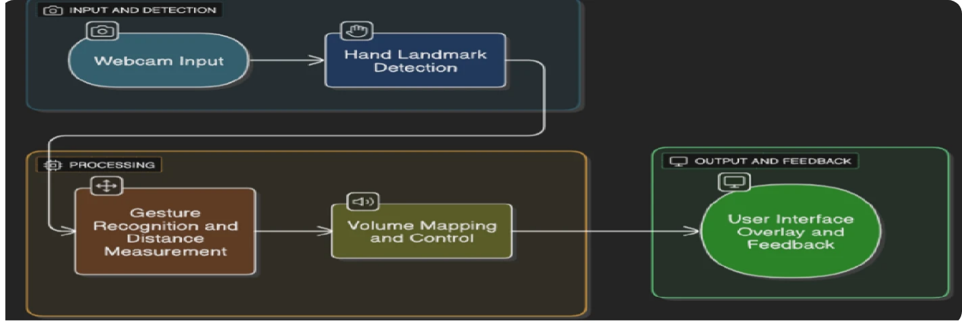


Architecture Diagram
Components:
1
2
Webcam Input
MediaPipe Hand Detector
captures frames
detects 21 landmarks
3
4
Gesture Analyzer
Volume Control Logic
calculates distance
maps distance to volume percentage
5
UI Feedback
overlays volume level on video feed

Slide 5
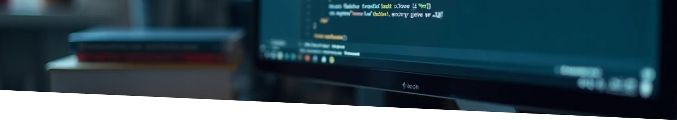

Implementation Details
Language and Libraries
Key Features
• Language: Python
• Real-time gesture detection
• IDE: PyCharm
• Dynamic system volume adjustment
• Libraries: OpenCV, MediaPipe, PyAutoGUI, NumPy, Math
• Smooth transitions without hardware

Slide 6
Objectives
To develop a system that allows users to control
the computer’s audio volume using hand
gestures through real-time image processing.
To enhance user convenience and accessibility
by replacing traditional input methods with
gesture-based volume control

Slide 7
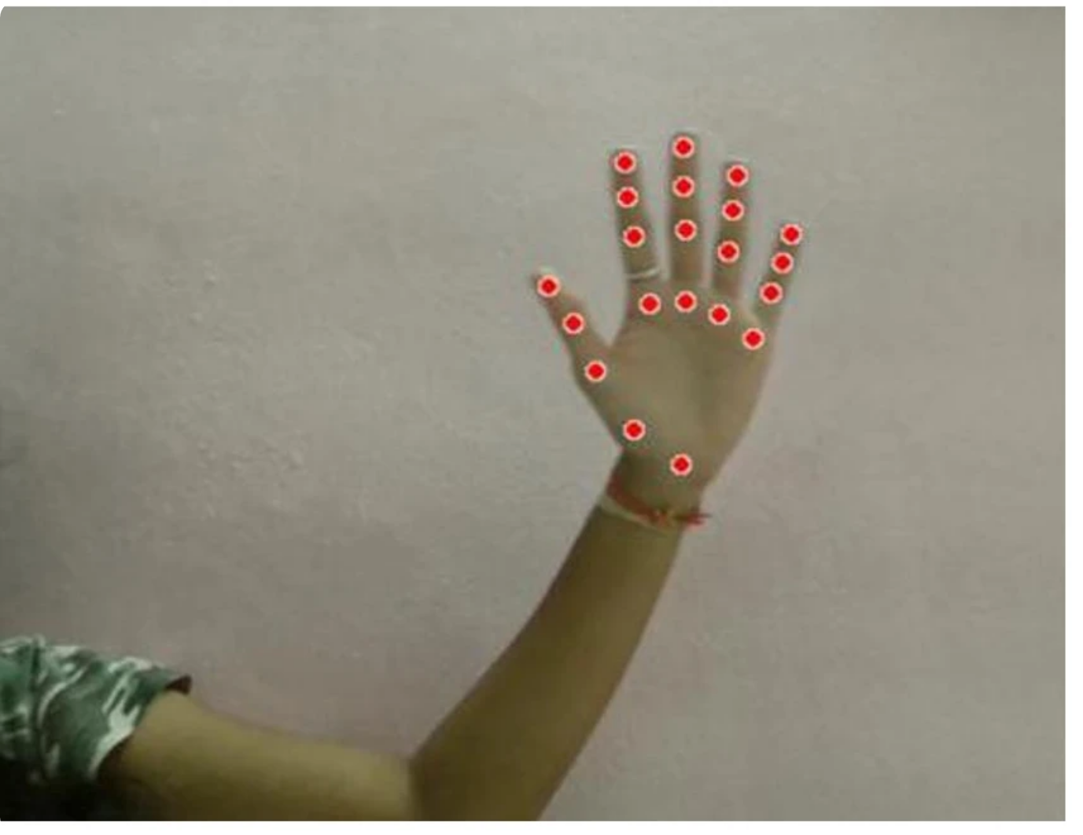
Milestone 1
Module: Webcam Input & Hand Detection
Tools: OpenCV, MediaPipe
Tasks: Integrated webcam, detected 21 hand landmarks.
Output: Live webcam feed showing hand landmarks.

Slide 8
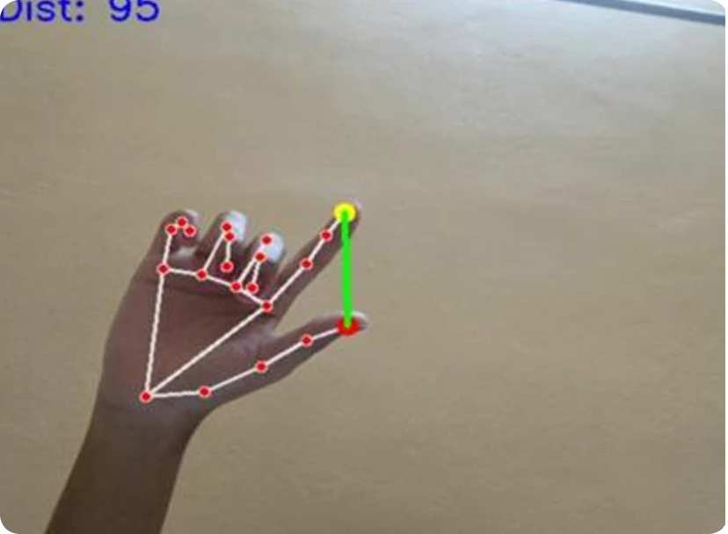
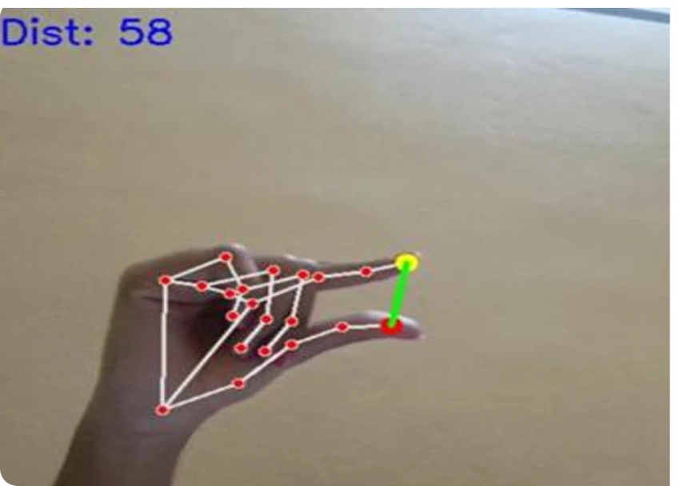
Milestone 2
Module: Gesture Recognition & Distance Measurement
Tasks: Calculated distance between thumb and index finger,
classified gestures.
Output: Displayed distance values and gesture annotations.

Slide 9

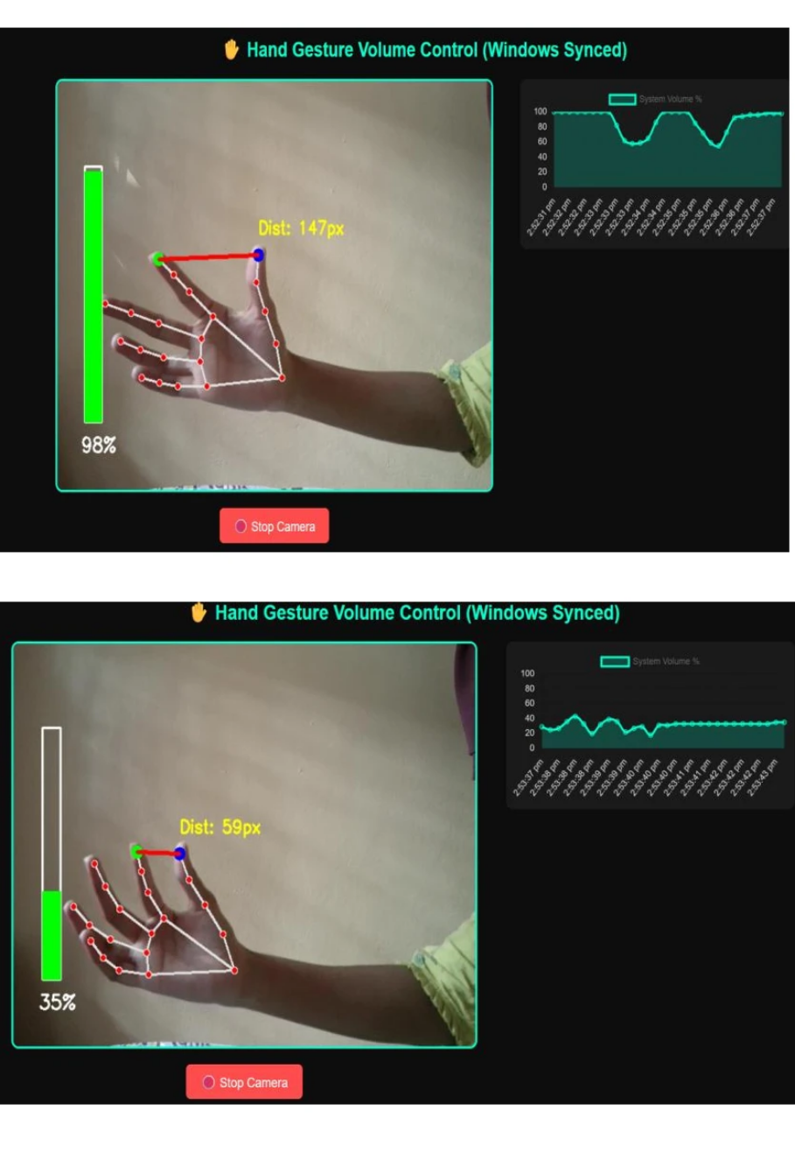
Milestone 3
Module: Volume Mapping & Control
Tasks: Mapped gesture distances to volume levels,
integrated Pycaw for control.
Output: Smooth, real-time system volume control.

Slide 10
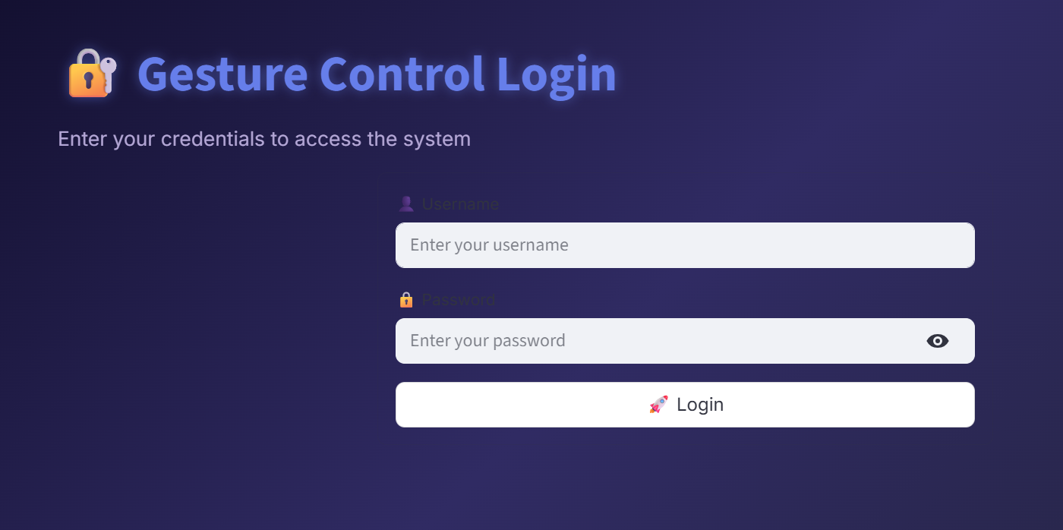
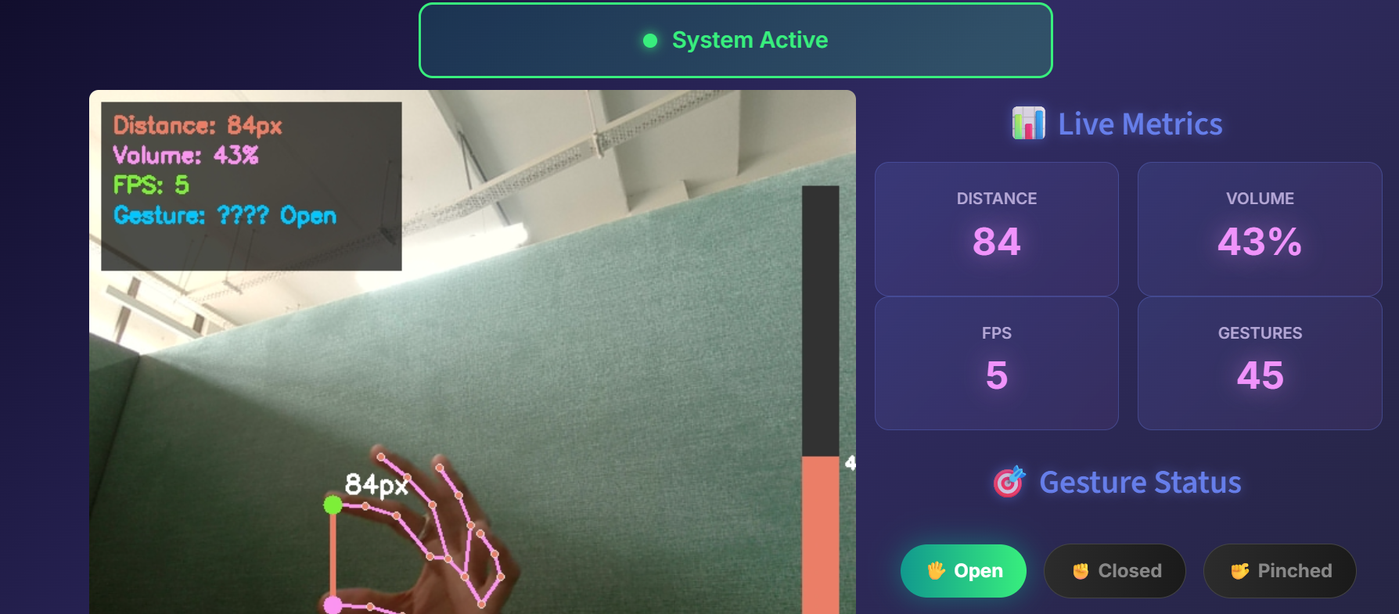
Milestone 4
Module: User Interface & Feedback
Tasks: Displayed feedback messages: “Min Volume”,
“Max Volume”, “Good Gesture”, “Volume
Increasing/Decreasing”.
Output: Real-time gesture recognition with
visual feedback.

Slide 11
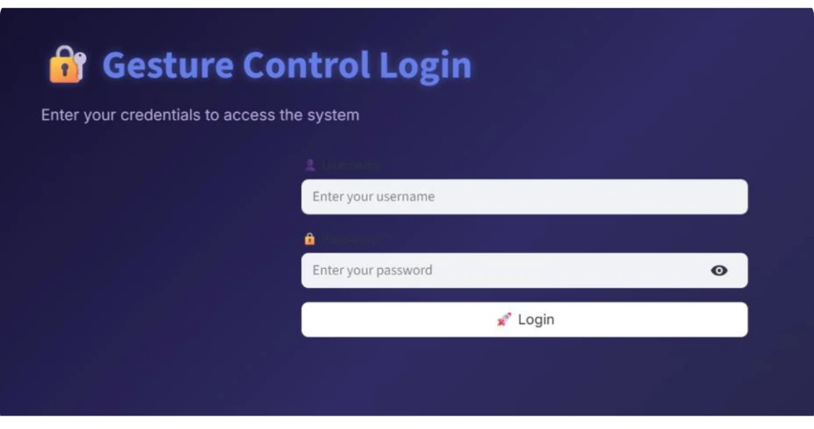
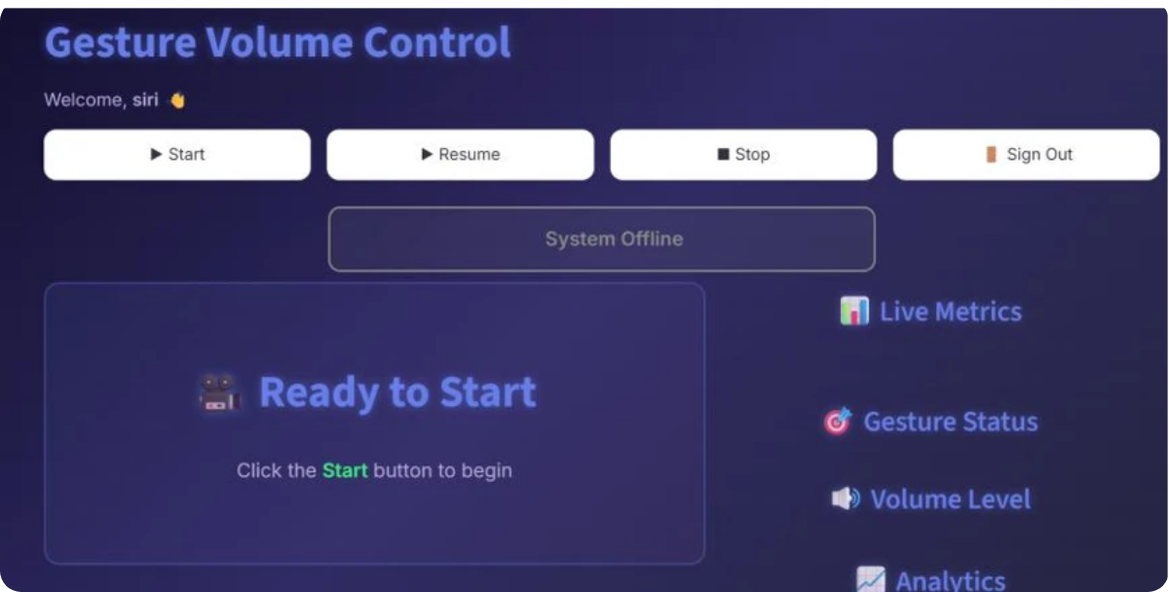



Final Result
1
Fully functional system adjusting Windows volume using hand gestures.
2
Real-time visual feedback with UI overlay.
3
Works smoothly without mouse or keyboard.

Slide 12
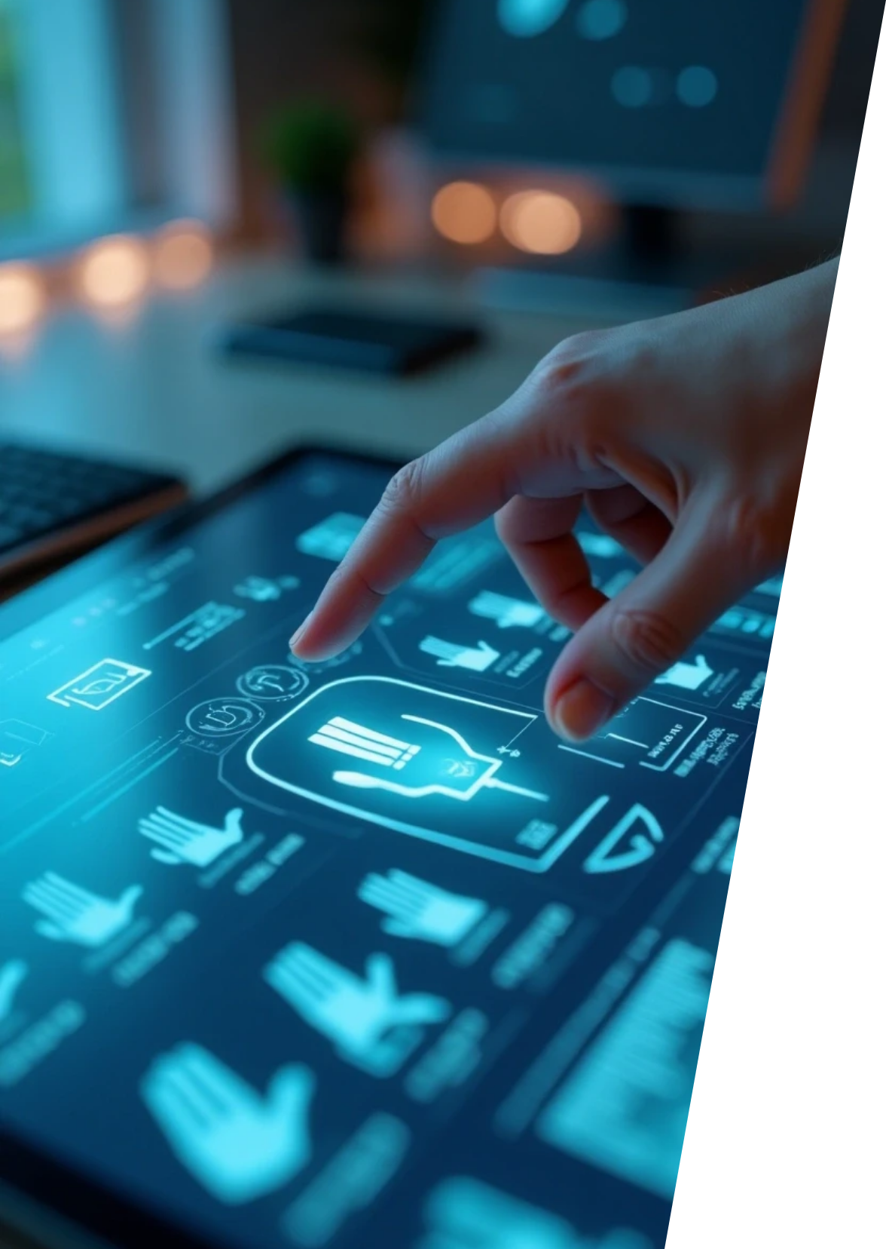






Challenges Faced and Solutions Implemented
1
2
3
Hand Detection
Gesture Errors
Performance Lag
Improved accuracy with optimized MediaPipe settings.
Fixed misread gestures using stability checks.
Reduced FPS drops by optimizing code and frame size.
4
5
Volume Fluctuation
UI & Security
Enhanced interface with CSS and added a login page.
Added smooth control using distance thresholds.

Slide 13

Future Implementations
Integration with other media controls – Extending the system to control
play, pause, brightness, and other system functions using different gestures.
Support for multiple devices – Adapting the project to work on mobile phones,
smart TVs, or IoT devices for a wider range of applications.
.

Slide 14
Conclusion
The project successfully implements gesture-based system volume control. It enhances interaction using AI and computer vision for hands-free control.
.

Slide 15

Thank You

